Slide 1
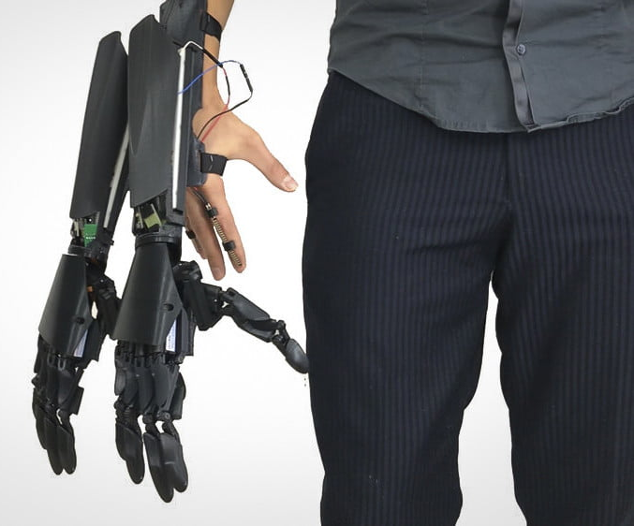
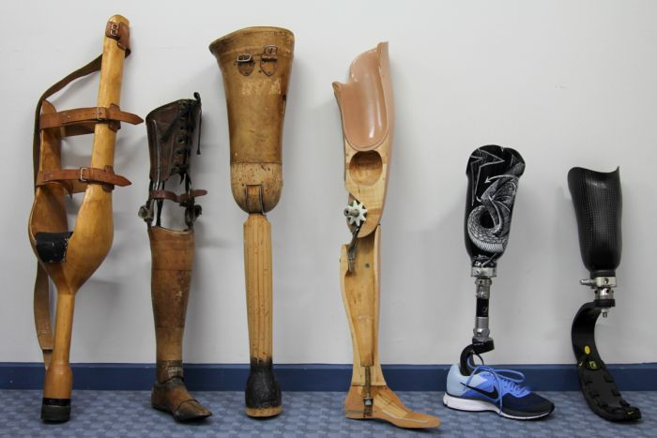
STEM Month Design Challenge
Design a prosthetic to make aid people with a limb difference
Rules:
The prosthetic can be for any limb
It should make doing a certain activity easier. (the activity is up to you)
Submissions:
Can be one of the following
A detailed sketch on no more than 1 A3 piece of paper
A CAD model presented on 1 A3 piece of paper
A physical model prototype (working or not working is fine)
Prize for the best design:
A signed cap from 7 time F1 world champion Lewis Hamilton and 9 time f1 race winner Valtteri Bottas
Deadline 30th of June
Work must be submitted to Simon in person or via email sza@collters.ac.uk

